Slide 1
2020 Training
New Registry: Clinigence

Slide 2
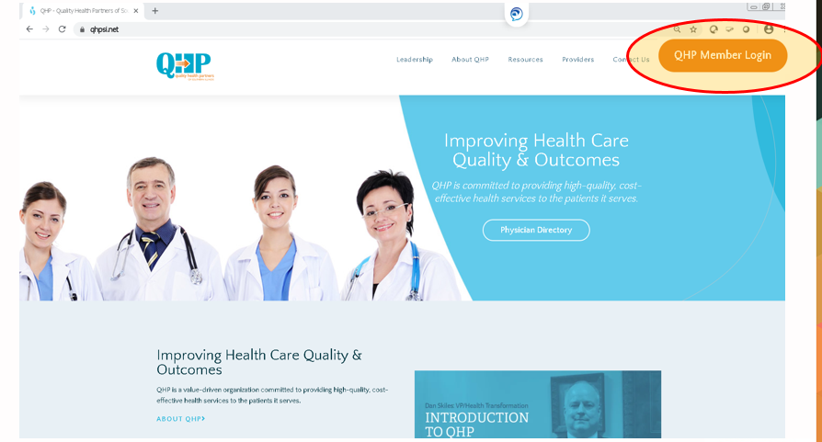
QHP Registry- Login
To log in to the QHP Registry, go to the QHP website (www.qhpsi.net) and click the button shown below.

Slide 3
QHP Registry - Login
Your username will be your professional email address.
Each QHP provider practice has a user access administrator.
If you do not have a username and/or you do not know who your organization’s user access administrator is, contact the QHP office coordinator at (618) 457-5200 x 67906.
If you forget your password, select the Reset/Forgot Password link on the login screen. An email will be sent to you with instructions for re-setting your password.

Slide 4
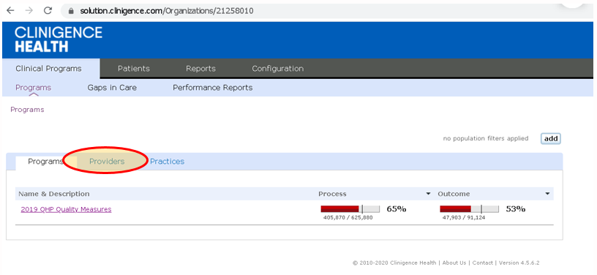
QHP Registry- Navigating
Providers checking their scorecard should first click the Providers tab.
After clicking providers, you can search the provider name. Use ctrl+F, then enter the provider’s last name in the search box. This tool is helpful for larger provider groups.

Slide 5
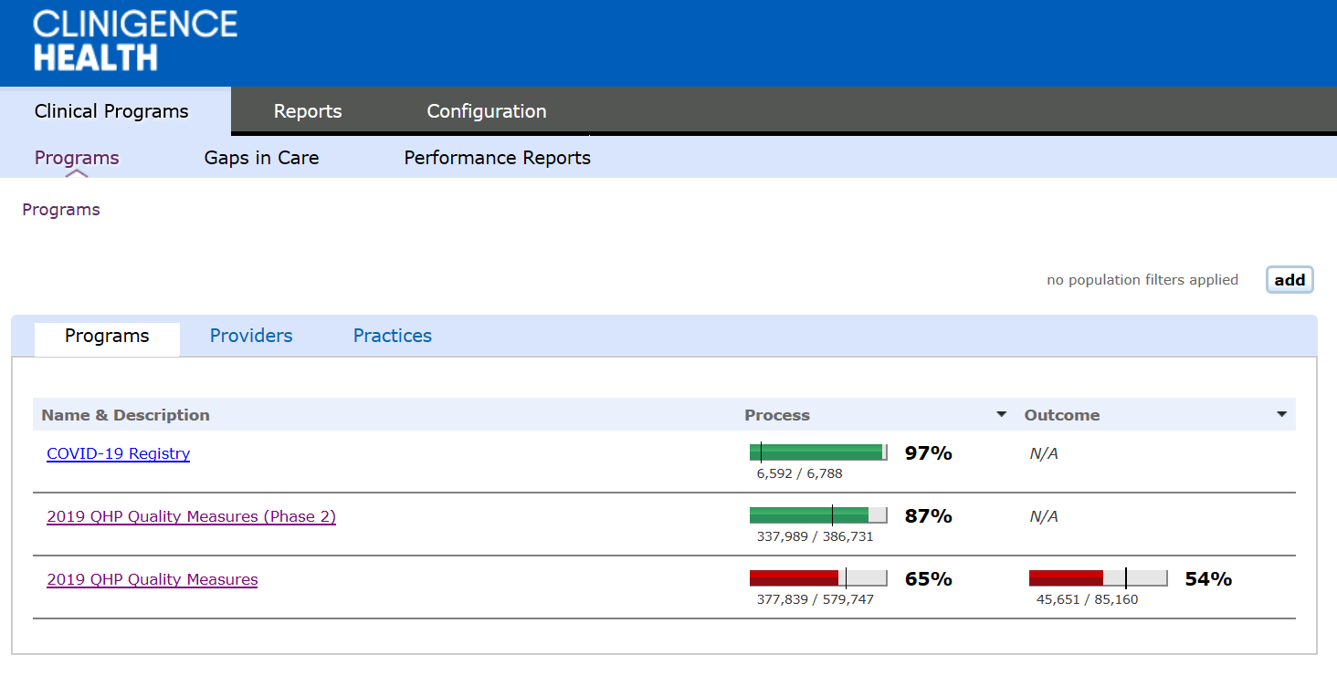
QHP Registry- Programs
The active programs for QHP within this registry tool are named 20xx QHP Quality Measures and 20xx QHP Quality Measures (Phase 2). Click these links to drill down to the measure level.
There is also a Covid-19 Registry.

Slide 6
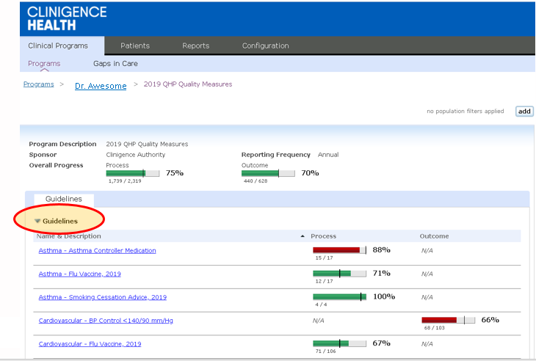
QHP Registry- Guidelines
The guidelines contain our set of QHP measures. Click on the measure name twice (not double click; two levels) in order to drill down to a patient list.
Click ‘Name & Description’ in order to alphabetize the measure set.

Slide 7
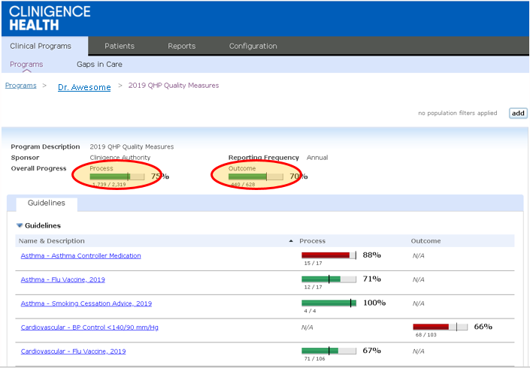
QHP Registry- Guidelines
An example of a process measure is LDL screening (did the qualifying patient have LDL tested?).
An example of an outcome measure is LDL control (was the qualifying patient’s LDL at a defined level?).

Slide 8
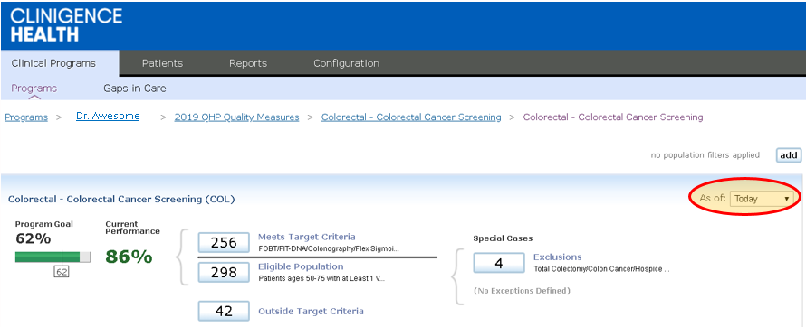
QHP Registry- Measures
QHP measure calculations will either show as a percentage or Met/Not Met.
All QHP measure definitions can be found at https://support.clinigence.com/support/solutions/folders/3000017063
Notice the ‘As of’ option, this can be set to either ‘today’ or December 31 of the prior measure year.

Slide 9
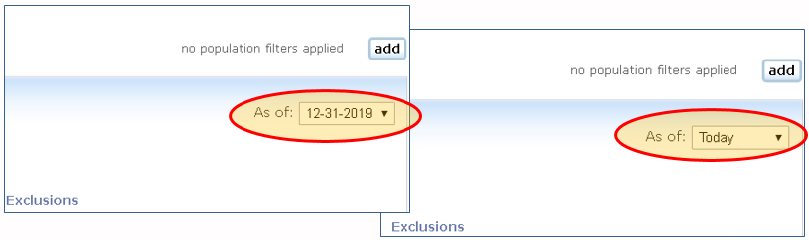
QHP Registry- Measures
‘Today’ is the default selection for the registry.
Under the default, this is a rolling twelve (12) month registry.
To look at the final score for the previous measure year, the default must be changed to 12-31-20xx in the drop down box.
For Phase 2 Measures, the date span must be changed to 12-31-20xx. Data ‘as of today’ is not accurate.
The implication of moving to a rolling measure year is a need for providers to check the registry regularly. Monthly is recommended, but quarterly will meet bonus measure criteria.
For example, if a patient had an A1c performed on 6/1/2019, the patient will show as Met until 6/2/2020, at which point they will show as Not Met.
To contrast, our previous registry ‘reset’ at the beginning of a new calendar year. This system does NOT allow for the measure year ‘reset’.

Slide 10
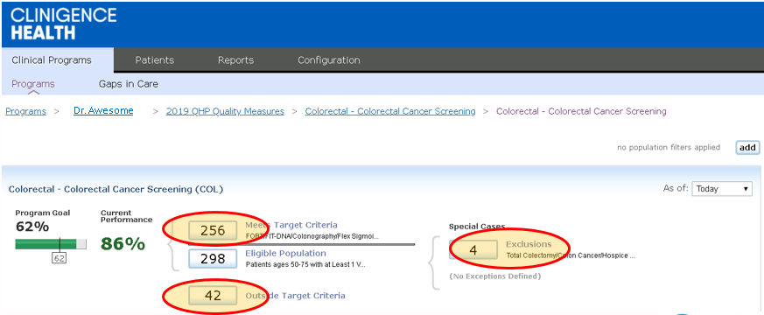
QHP Registry- Measures
Click on any of the boxes to drill down to the patient level.
Meets shows patients who are meeting the measure; Outside shows patients who are not meeting the measure.
You can also view the entire Eligible population or any measure Exclusions or Exceptions.

Slide 11
QHP Registry - Measures
Eligible Population (Denominator)- patients who meet the criteria for the measure denominator.
Meets Target Criteria- patients who meet the criteria for both the denominator and numerator of a measure.
Outside Target Criteria (Complement/Not Met)- patients who meet the criteria for the denominator of a measure, but do not meet the numerator criteria.
Exclusions and Exceptions- patient would have qualified for denominator, but has criteria that excludes them from counting against a provider’s score. For example, patient no longer qualifies for Breast Cancer Screening due to previous mastectomy.

Slide 12
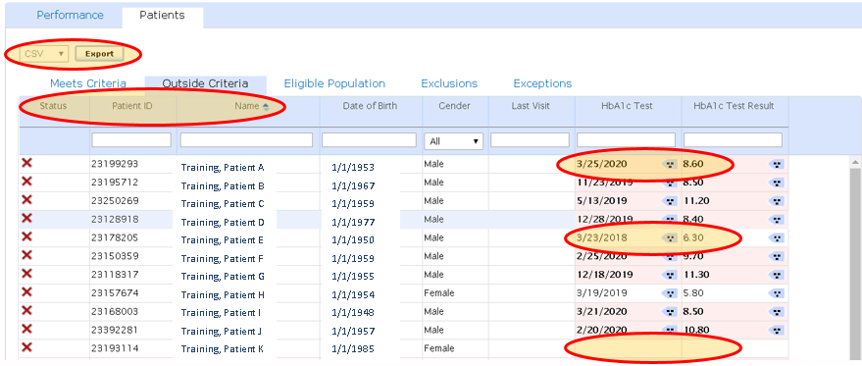
QHP Registry- Patient Lists
This list can be exported and converted to Excel.
You can sort by any column: Name, Last Visit, Test Result, etc.
This is an ‘outside criteria’ report. Patients may fall outside criteria because a test result is too high, because the date of the test is too old, or because there is no test result showing in the system.

Slide 13
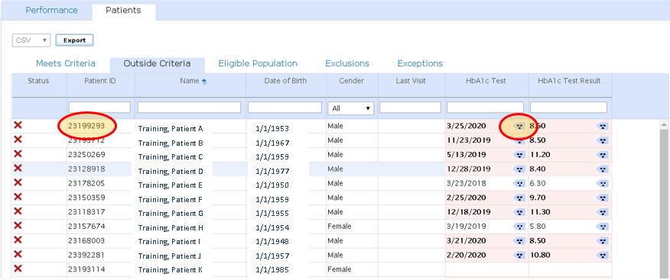
QHP Registry- Patient Lists
The 3 dot (because) icon is where the user can see the data source. Clicking this button will show whether the data came from claims, EMR, or lab files, as well as which provider group submitted the data. For example, the HbA1c test result shown below may have come from the provider’s EMR or from Quest or LabCorp data (or other sources).
When reporting data issues to the QHP team, please include the Patient ID number. This number is not PHI, so can be sent via non-secure email as long as no other PHI is included.

Slide 14
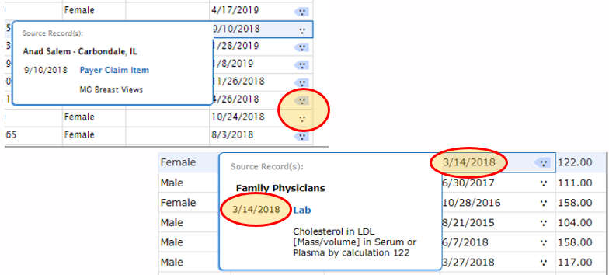
QHP Registry- Data Source
If the icon 3 dot icon, known as the ‘because’ icon, is blue, that indicates the qualifying data comes from outside the provider’s own practice.
If the because icon is white, the qualifying data comes from within the provider’s own practice.
For QHP data, there is often a one-day difference in the data shown on the Clinigence patient list versus the data source information. The date on the actual patient list is the correct date; please rely on this date for data validation.

Slide 15
QHP Registry – Data Issues
Following is a note regarding a common data issue the QHP team has discovered during data validation: Patient Matching
Patients are matched in Clinigence based on first name, last name, birth date, and gender.
We commonly see different first and/or last names appearing between claims and EMR data.
If you see this issue, please report to the QHP team (contacts listed on the last slide). We will need both patient names and Clinigence id numbers, as well as an indication of which patient name is correct.
Examples include: William vs Bill, Smith-Jones vs Smithjones or Smith Jones, and name changes due to marriage or child/guardian relationships.
We will have the patients merged in Clinigence; when patients have been merged once, they are merged for all future data transactions.
The impact of patient matching issues is that both spellings appear in the registry; one shows ‘met’ and one shows ‘unmet’ because the EMR and claims data cannot find each other.

Slide 16
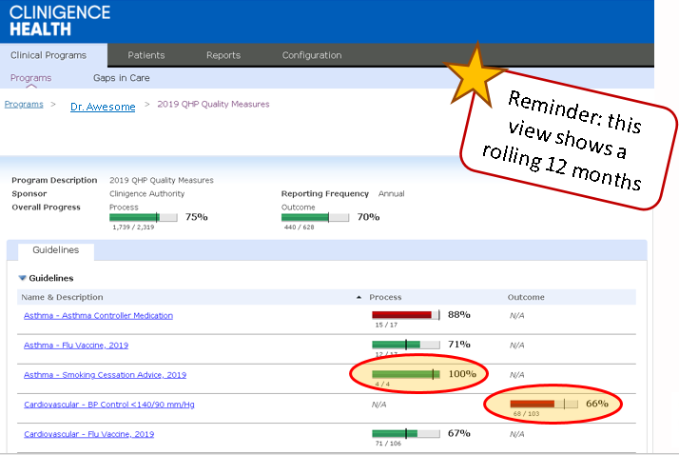
QHP Registry- Targets
A green progress bar indicates the provider’s score for that measure is above the target for the bonus year.
A red progress bar indicates the provider’s score for that measure is below the target for the bonus year.

Slide 17
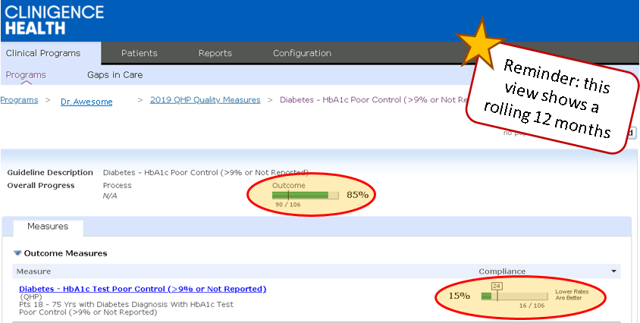
QHP Registry- Inverse Measures
There is only one (1) inverse measure in the QHP measure library, Diabetes: Poor Control HbA1c > 9%.
For this measure only, the progress bar shows green when the score is LOWER THAN the target.
Notice the high level roll up shows 85% instead of 15%; this helps the overall aggregate score represent appropriate high or low performance for this inverse measure.

Slide 18
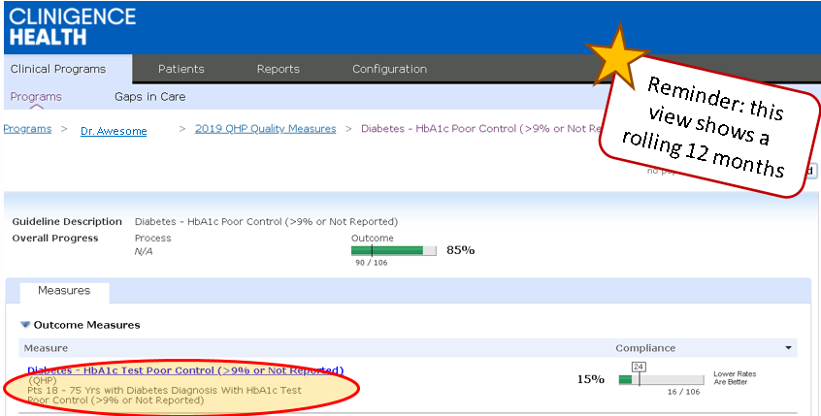
QHP Registry- Measure Definitions
A short version of the measure definition appears at this level.
To view the complete QHP measure definition details, go to the following link:
https://support.clinigence.com/support/solutions/folders/3000017063

Slide 19
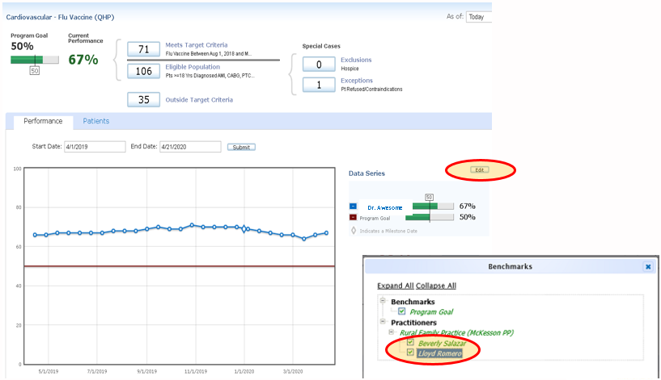
QHP Registry- Trend Lines
Trend lines provide a visual representation of the provider’s performance over time.
You can combine multiple providers in the same trend line by clicking the Edit button, then clicking a checkbox for each additional provider.

Slide 20
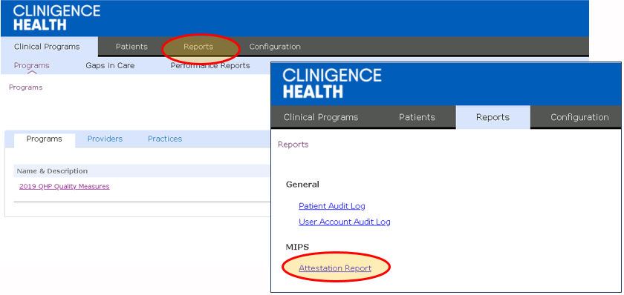
QHP Registry- Reports
You can view your complete measure year scorecard.
From the home screen, select ‘Reports’, then select ‘Attestation Report’.

Slide 21
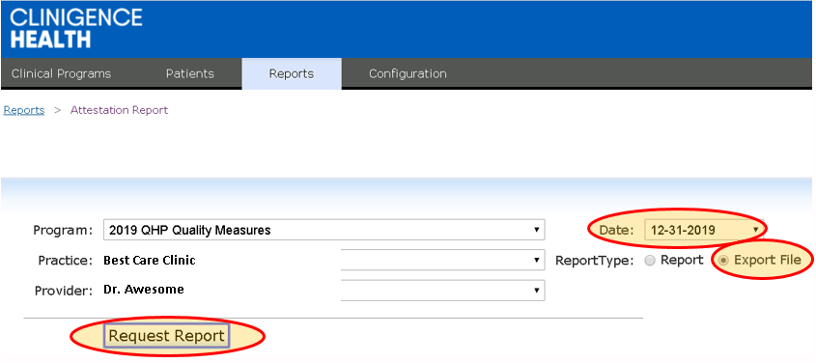
QHP Registry- Reports
Complete the fields as indicated below.
Using ‘Export File’ provides the results in Excel format. The following data elements are included in the reports: Measure Name, Population Count, Numerator/Denominator/Exclusion Counts, and Rate/Score.
Targets are NOT included in this report; the report does not indicate whether a provider Met for that measure.

Slide 22
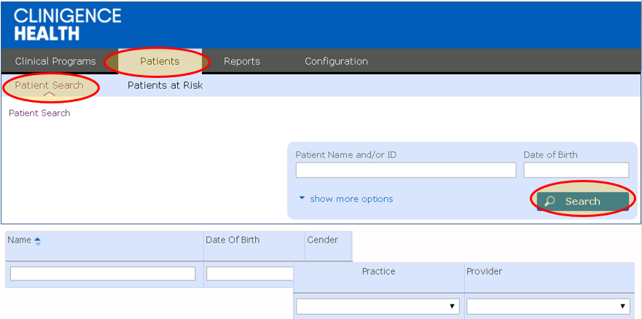
QHP Registry- Patient Search
To search a specific patient, go to ‘Patients’ from the home screen, then select Patient Search.
Enter Name, Clinigence ID, or Date of Birth and click ‘Search’.
The search results will return the fields shown below.

Slide 23
Thank You!!!
If you have questions, please contact:
Dan Skiles, Executive Director QHP
daniel.skiles@sih.net
918.457.5200 x67909
Kevin Oestmann, MD, Chief Medical Officer
kevin.oestmann@sih.net
618.457.5200 x68558
Jenny Hertter, Business Manager
jennifer.hertter@sih.net
618.457.5200 x67201
Lindsay Tolcou, PHO Operations Manager
lindsay.tolcou@sih.net
618.457.5200 x67911

