Slide 1
Reducing Rural Colon Cancer Disparities through Multi-level Interventions in Follow-up after Abnormal Screening Tests
The SAFESTEP Study
Aimee S. James, PhD, MPH
Associate Professor
Div. of Public Health Sciences, Dept. of Surgery
Washington University School of Medicine

Slide 2
Overview of the Study
Phase 1 (completed): Learn about current practice and capacity for colorectal cancer screening and follow-up by meeting with primary care and gastroenterology clinics within SIH.
Phase 1b (completed): Conduct surveys and interviews of patients from the region to learn more about issues related to the cost of screening and other patient level barriers.
Phase 2a (completed): Pilot test an intervention toolkit to improve colorectal cancer screening and follow-up of positive tests.
Phase 3 (Ongoing) Multi-level intervention in collaboration with primary care practices who are part of the PHO. Stepped-wedge design, allowing for tailoring and continual improvement of the toolkit.

Slide 3

Multilevel Intervention: Ongoing
SAFESTEP Trial
  PHO member sites will receive the study toolkit at different points during the intervention period
  Gradually introducing the toolkit to sites over the course of the study allows for tailoring and modifying the toolkit to best fit each site, and continuous improvement
  Participating clinics will receive the toolkit, as well as assistance and resources to support implementation

Slide 4
Multilevel Intervention: Ongoing
Toolkit
SAFESTEP Toolkit developed based on insights from interviews, input from the SIH team, and best practices for CRC screening and follow-up.
Multilevel: includes tools and resources for patients, providers and staff, and clinics/organizations.

Slide 5
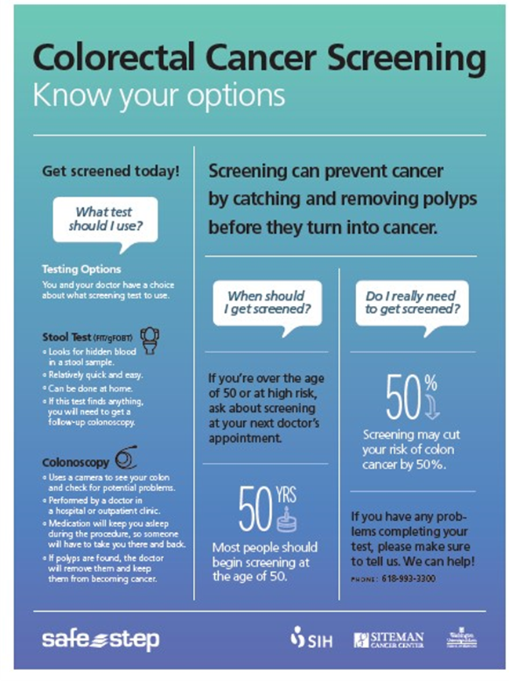
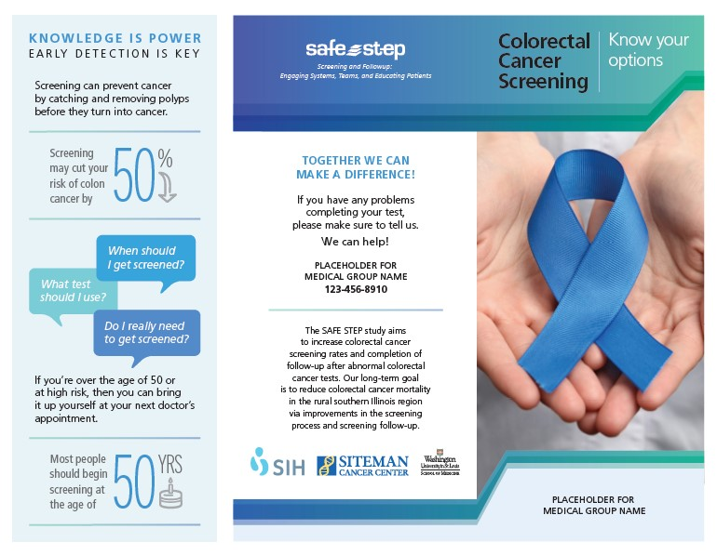
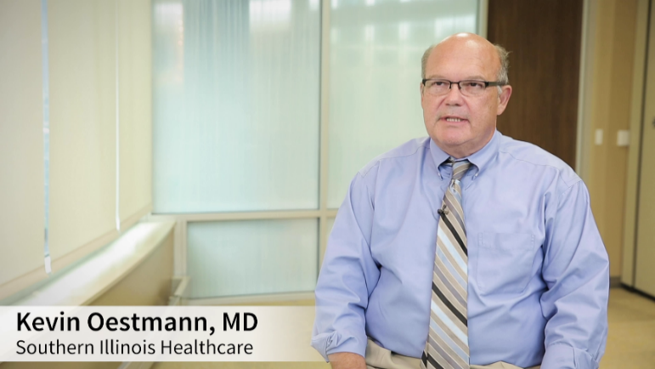
Multilevel Intervention: Ongoing
Toolkit components include:
Patient education materials at accessible reading level

Slide 6
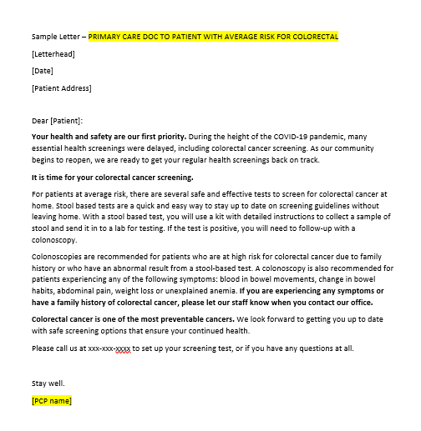

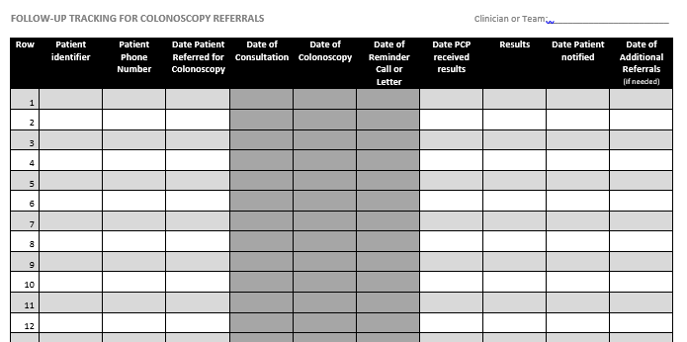
Multilevel Intervention: Ongoing
Toolkit components include:
Provider and staff education modules on colon cancer incidence and mortality, screening recommendations, types of screening tests and benefits/costs of each, common patient barriers and how to address them
Guide to local resources to address common patient barriers
Resources for clinics to assess workflow and implement reminder and tracking systems for screening and follow-up
Lots of additional resources

Slide 7
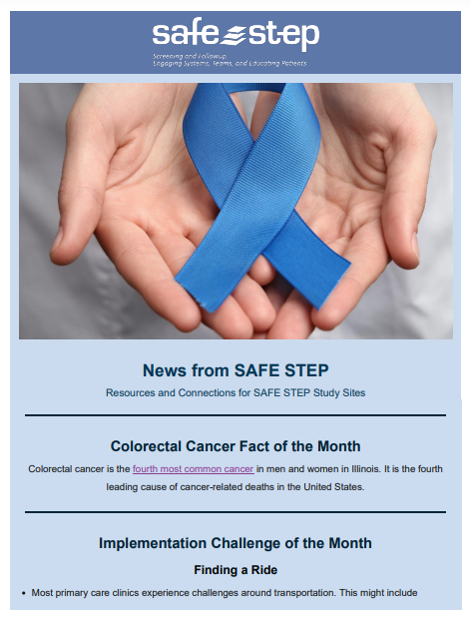
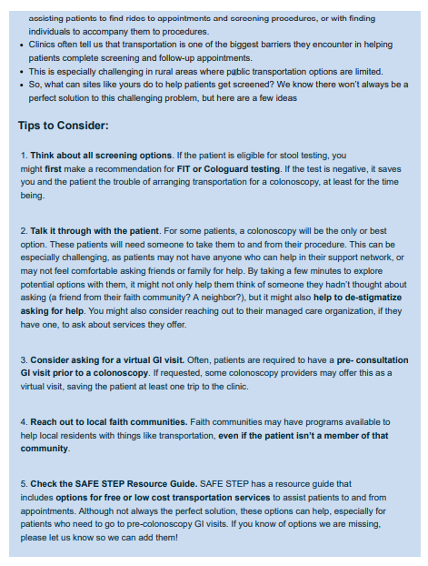
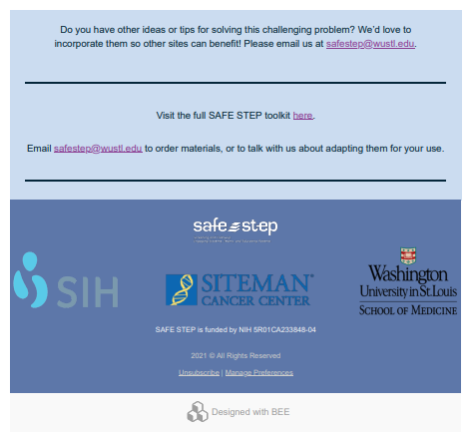
Multilevel Intervention: Ongoing
NEWLY ADDED Components Include:
Bi-Monthly Newsletter featuring a topic or barrier of interest and tips and tools for addressing it
Conversation Guide for providers and patients to help discuss pros and cons of each type of colorectal screening test
Community Event Guide with information about participating in screening events in the community

Slide 8
Study Progress
SAFESTEP materials are now in use at 10 Clinics in 2 health systems
Toolkit components in use include:
  Education materials (posters and brochures)
  Workflow diagraming and identifying areas for potential change
  Community outreach and screening events
  Provider and staff education (newsletter, modules)

Slide 9
Challenges
We recognize many challenges remain as a result of Covid19, including provider shortages and long wait times for colonoscopy
We understand how frustrating the situation might be for providers and systems, and how this type of intervention might not seem timely
Or approach is flexible rather than one size fits all to account for these types of challenges

Slide 10
Potential Areas for Further Development
Currently in the system there is a range of provider level screening rates from 16% to above 80%.
One option to help with this could be facilitating access and interest in stool testing when colonoscopy is not immediately available
  (e.g., making kits available in clinic rooms, facilitating conversations about stool testing)

Slide 11
Next Steps
SAFESTEP is continuing to work with clinics in the PHO
If your clinic or system is interesting in learning more about our tools for improving screening rates, please reach out to Aimee or Julia.

Slide 12
WUSTL Contact Information
WUSTL Principal Investigator
Aimee James, PhD, MPH
aimeejames@wustl.edu
WUSTL Coordinators
Julia Maki, PhD
jmaki@wustl.edu
Natasan McCray, MHA
nmccray@wustl.edu
Amy Ayala, MPH
aayala@wustl.edu

Slide 13
Supplementary Information
Table 1. Provider colorectal cancer screening rates, by healthcare system (3rd quarter – 2022)
¹ There are ~ 23,300 that could not be matched to a provider or clinic and thus aren’t included in the screening rates
System | Number of clinics | Total number of patients at clinics | Range of provider screening rates¹
Anad Salem | 1 | 940 | 82.8
Christopher Rural Health Planning Corporation | 12 | 14,760 | 15.8 – 43.0
Community Health and Emergency Services Inc. | 5 | 2,005 | 21.4 – 41.4
Javier Muniz DO | 1 | 19 | 78.9
Murphysboro Family Medicine | 1 | 347 | 27.7
Rural Health | 5 | 4,887 | 14.0 – 35.8
SIH Medical Group | 11 | 32,878 | 44.9 – 70.2
SIU Healthcare | 2 | 4,181 | 58.4 – 67.8
Shawnee Health Service | 6 | 8,323 | 40.7 – 57.5
Shirley Ryan AbilityLab | 1 | 5 | 60.0

